Slide 1

YARN(Yet Another Resource Negotiator)

Slide 2

Now
Management in terms of assignment and Failure
Need for YARN
YARN Architecture
Job submission lifecycle – YARN
Scheduling
Failure Handling
Benefits of YARN

Slide 3
Scheduling in YARN
Notes:
Exercise
Write a similar program for
Finding the words in a file
For each word, calculate the count
Assume the file contains the string
“To be or not to be”
Hint
This should be done in parallel
In the blue boxes, read in each line in the file
If the line is w1 w2 w3 w4, then output 4 lines w1 1 w2 1 w3 1 w4 1

Slide 4
YARN
What happens when we submit a Job?
Job is submitted to Yarn
Resource Manager
Node Manager
Node Manager
RM schedule based on
job constraints and Capacity
Node Manager
Node Manager

Slide 5
YARN
Schedulers in Hadoop
FIFO Schedular( Apache)
Capacity Schedular(Horton)
Fair Schedular(CloudEra)

Slide 6
YARN Schedulars
FIFO Schedular
First In First Out Schedular
Resources are allocated in first in first out basis
Requests made first are served first
Time | Job ID | Total | Pending | Running | Completed | AM | Cluster Size
8:00 | J1 | 50 | 35 | 15 | 0 | 1 | 16
8:10 | J1 | 50 | 20 | 15 | 15 | 1 | 16
8:15 | J2 | 2 | 2 | 0 | 0 | 0 | 16
8:20 | J1 | 50 | 5 | 15 | 30 | 1 | 16
8:20 | J2 | 2 | 2 | 0 | 0 | 0 | 16
8:30 | J1 | 0 | 0 | 5 | 45 | 1 | 16
8:40 | J2 | 2 | 0 | 2 | 0 | 1 | 16

Slide 7
YARN Schedulars
FIFO Schedular
Capacity Utilization
Maximum Capacity of the Schedular
1
2
Waiting time is too long
Time

Slide 8
YARN Schedulers
Capacity Schedular
Capacity is distributed to different queues.
Each queue is allocated a share of cluster.
Jobs are submitted to a specific queue.
Within a queue the jobs are executed in FIFO order.
Suppose if we have 4 queues, 4 jobs running at any point of time.

Slide 9
YARN Schedulars
Capacity Schedular
Capacity Utilization
Maximum Capacity of the Schedular
2
Queue 2
1
Queue 1
Time

Slide 10
YARN Schedulers
Capacity Schedular
Major Advantage over FIFO
Smaller jobs need not have to wait indefinitely till the larger jobs completes
Trade Off
Cluster might be underutilized

Slide 11
YARN Schedulers
Fair Schedular
Tries to be fair to all the jobs submitted to Hadoop Cluster.
Resources are always proportionally allocated to all jobs.
If one job it gets all the resources, if its 2 job gets 50% of the resources.
3 jobs 33% percent of all the resources
No Wait time

Slide 12
YARN Schedulars
Fair Schedular
Capacity Utilization
Maximum Capacity of the Schedular
2
3
1
3
Queue 2
2
1
1
Queue 1
Time

Slide 13
YARN Schedulers
Fair Schedular
Consider a user who submits more jobs
Scheduler ensures → that user does not hog the cluster
Custom pools
Guaranteed minimum capacities with map/reduce slots
It is also possible to define custom pools with guaranteed minimum capacities defined in terms of the number of map
The Fair Scheduler supports preemption
If pool not received its fair share over certain time
scheduler will kill tasks in pools running over capacity

Slide 14
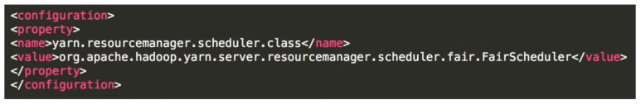
Configure the Schedular
After defining cluster
By default certain schedular is configured
If we want to change the schedular, it can be overridden manually using the yarn-site.xml file.

Slide 15
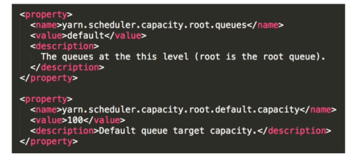
Configure the Schedular
Capacity Schedular
Along with this different configurations are stored in capacity-schedular.xml

Slide 16
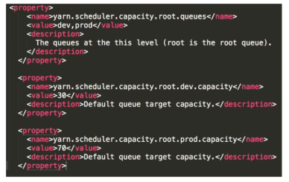
Configure the Schedular
Configuring Two Queues- Example

Slide 17
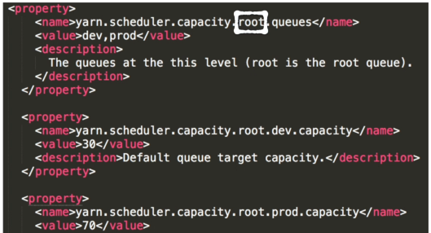
Configure the Schedular
Creating Hierarchies

Slide 18
Configure the Schedular
Assigning Job to a specific Queue
When you submit a job, you can specify the queue using mapred.job.queue.name property
Queues can be configured based on the type of tasks/type of users
Daily runs Vs Adhoc runs
Data Analysts Vs Engineers
Production Jobs Vs Test Runs

Slide 19
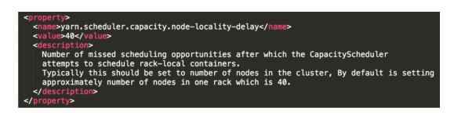
Configure the Schedular
Delay Scheduling
In a capacity-schedular.xml there is a property called node-locality-delay.

Slide 20
THANK YOU
“WORLD IS ONE BIG DATA PROBLEM”
“TORTURE THE DATA AND IT WILL CONFESS TO ANYTHING”

